Slide 1
NATURAL LANGUAGE PROCESSING
HOMEWORK – 2
By Ravinthiran Partheepan

Slide 2
Query
Try to construct at least few rules for the stemmer (for any language you want!)
Try to construct a list of stop words for the sentiment analysis task (for any language you want!)

Slide 3
Technical Aspects
Programming Language Used :- R Script
Package Used :- R <- “stopwords” “tm”
For Stemming the stopwords i have used Paste().
The package ‘tm’ is used for text mining.

Slide 4
Solution for the Query
In natural language processing, useless words (data), are referred to as stop words.
I have assigned two Variables Stopwords and Stopwords1
EN= Stopwords && IT=Stopwords1
With the Help of Stopwords and tm Library in R, it is easy to stem the stopwords.
Stopwords[En] <- “as if ourselves......”
Stopwords1[IT] <- “ad,ai,dei....”
Stopwords2 <- (Stopwords(C(‘They_if’)) & stopwords(C(‘ai_dei’)))
Stopwords2 <- They_if_as & ai_dei_ad

Slide 5
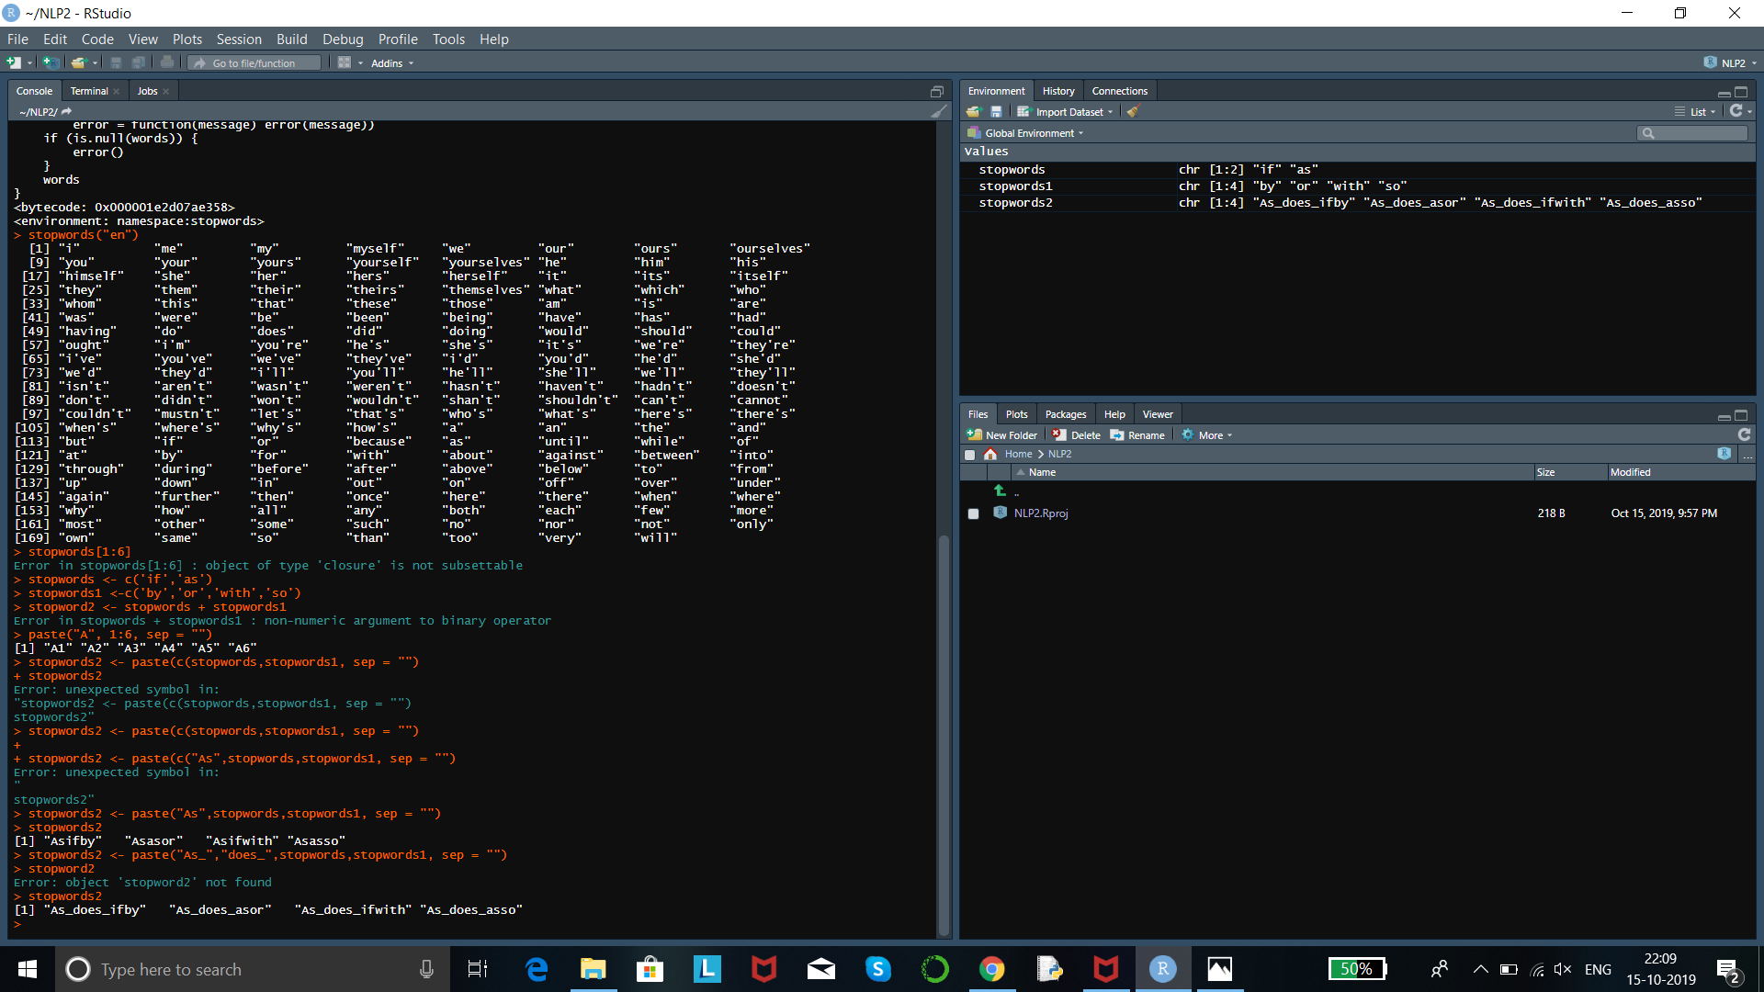
Program Code

Slide 6
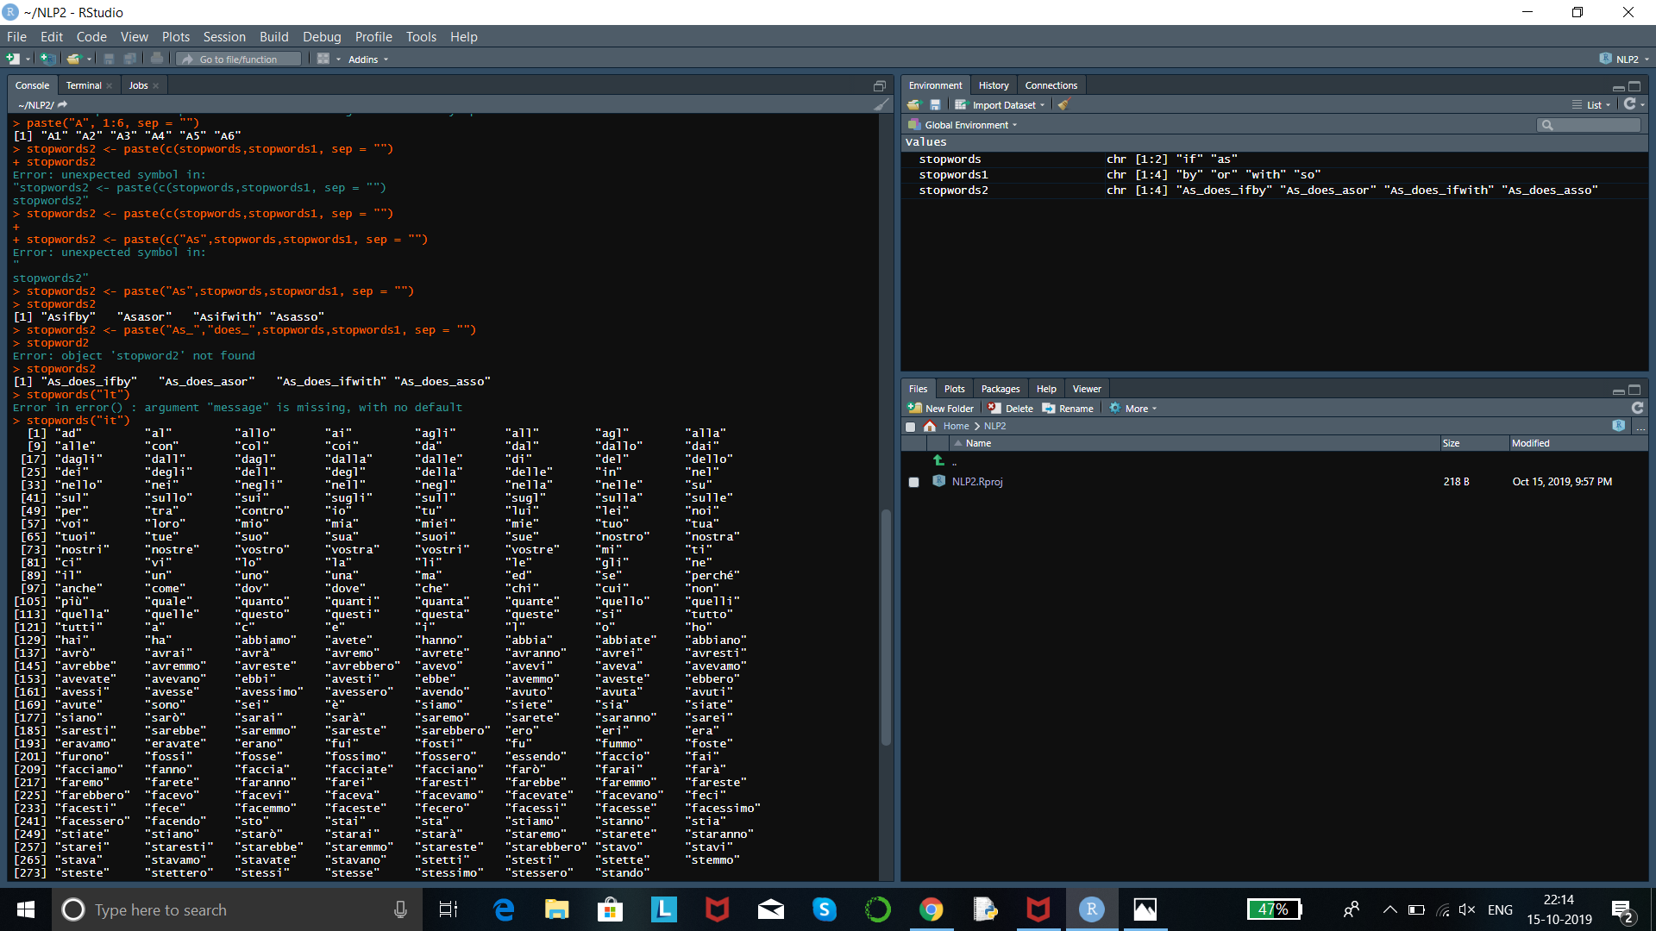
Program Code

Slide 7
Output for EN(English)

Slide 8
Output for IT [Italian]

Slide 9
Thank You!

